Slide 1

Learning Objective
I will review my work on whole numbers.
Enter quietly, please be ready with the following on your desk:
Whiteboard
Whiteboard marker
Exercise Book
Pencil, pen, ruler and red pen
Diary
Calculator
Device – charged or borrowed from Library before maths

Slide 2
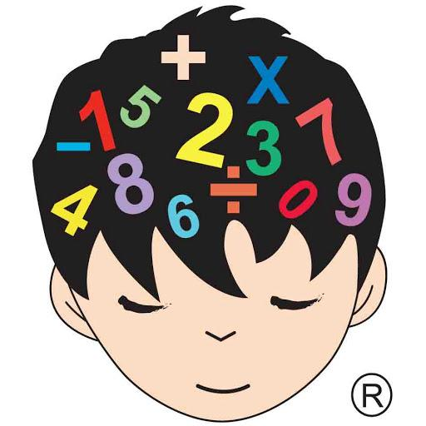
Daily Review
CFU
What does the commutative law state?
Commutative law – the order in which I add or multiply any two numbers does not change the answer
CFU
Write another example of the commutative law.
7 x 5 = 35
5 x 7 = 35
7 + 8 = 15
8 + 7 = 15

Slide 3
Daily Review
CFU
What does the associative law state?
Associative law – the order in which 3 or more numbers are added or multiplied, does not change the results
CFU
Write another example of the associative law.
2 x 3 x 5 = 30
3 x 5 x 2 =30
6 + 7 + 8 = 21
7 + 6 + 8 = 21

Slide 4
Question
There may be more than one!!
Which of the following are examples of the commutative law?
A: 3 + 7 = 7 + 3
B: 10 + 6 = 6 + 10
C: 5 x 6 = 6 x 6
D: 4 + 2 + 10 = 10 + 4 + 2
E: 4 x 8 = 8 x 4
F: 3 x 4 x 10 = 10 x 4 x 3

Slide 5
Question
Which of the following are examples of the associative law?
A: 3.2 + 7.4 = 7.4 + 3.2
B: 10 + 6 = 5 + 5 + 3 + 3
C: 17 x 3 x 6 = 6 x 17 x 3
D: 4 + 2 + 10 = 10 + 4 + 2
E: 3 x 4 x 18 = 3 x 8 x 14
F: 3 x 4 x 7 = 7 x 4 x 3

Slide 6
Daily Review
We will now add using the ‘make easy numbers’ strategy
Whiteboards
7 + 32 + 13
4 x 7 x 5
5 x 81 x 2
= 7 + 13 + 32
= 20 + 32
= 52

Slide 7
Daily Review
CFU 1
Why did we subtract 7 from 568?
We will now add using the ‘make easy numbers’ strategy
Whiteboards
293 + 568
198 + 342
695 + 226
= 293 + 7 + 561
= 300 + 561
= 861

Slide 8

Daily Review
CFU
What does the distributive law involve?
Distributive law – we split large numbers into 1s, 10s and 100s
CFU
Write another example of the distributive law.
16
16 is a large number so we split it into 10 + 6

Slide 9
Daily Review
Distributive law – we split large numbers into 1s, 10s and 100s
Whiteboards
2 x 13
2 x 43
57 x 8
= 2 x (10 + 3)
= 2 x 10 + 2 x 3
= 20 + 6
= 26

Slide 10
Daily Review
Break down each number into simpler multiplications:
= 4 x 2
= 2 x 2 x 2
8
12
= 4 x 3 = 2 x 2 x 3
Whiteboards
= 9 x 4 =
36
28 =

Slide 11
Daily Review
Use the “work in stages” strategy to calculate the following:
Step 1. Break down the smaller multiplier.
Step 2. Perform the multiplications one at a time.
Whiteboards
25 x 4
27 x 4
45 x 8
= 25 x 2 x 2
= 50 x 2
= 100

Slide 12
Daily Review
Use the “work in stages” strategy to calculate the following:
Step 1. Break down the smaller divisor.
Step 2. Perform the divisions one at a time.
Whiteboards
900 ÷ 15
200 ÷ 8
132 ÷ 12
= 900 ÷ 3 ÷ 5
= 300 ÷ 5
= 60

Slide 13
Daily Review
Use an array to solve the following multiplications:
Step 1: split the numbers into 1s and 10s.
Step 2: enter the numbers on the sides of the array.
Step 3: multiply each horizontal by each vertical and enter in the array.
Step 4: add up each number inside the array.
87 x 6
32 x 4
Whiteboards
49 x 8
80
7
30
2
6
480
42
4
480
+ 42
522

Slide 14
Daily Review
Use an array to solve the following multiplications:
94 x 32
44 x 83
Whiteboards
71 x 64
90
4
30
2,700
120
2
180
8
2,700
120
180
+ 8
3,008

Slide 15
Daily Review
Whiteboards
1) 94 x 10
2) 68 x 100
3) 342 x 1 000
= 940
= 6 800
= 342 000
4) 630 ÷ 10
5) 4 800 ÷ 100
6) 3 000 ÷ 1 000
= 63
= 48
= 3
7) 40 ÷ 20
8) 6 800 ÷ 200
9) 9000 ÷ 300
= 68 ÷ 2
= 90 ÷ 3
= 4 ÷ 2
= 34
= 30
= 2

Slide 16
Concept Development
CFU
Why do we use index notation?
Index notation – to save space when repeating a number multiplied by itself, mathematicians write in index form.
CFU
In 7⁸ what is the base?
5
INDEX or POWER
4
BASE
CFU
In 7⁸ what is the power?
4⁵ = 4 x 4 x 4 x 4 x 4 = 1,024
CFU
Write 9³ in expanded form.
Index Form
Expanded Form
Answer

Slide 17
Skill Development
VOCABULARY
Index Form – Simplified into a base and power
(e.g. 7³).
Write the following in expanded form:
Whiteboards
7³
VOCABULARY
7³
= 7 x 7 x 7
2⁴
Expanded Form – Showing all of the multiplications
(e.g. 7 x 7 x 7).
6³
= 6 x 6 x 6
58²
Write the following in index form:
3 x 3 x 3 x 3
= 3⁴
5 x 5 x 5 x 5 x 5
92 x 92
= 92²
4 x 4 x 4 x 7

Slide 18
Skill Development
VOCABULARY
Square – the result of a number multiplied by itself.
(e.g. 2 x 2 = 4).
A square is the result of a number multiplied by itself.
Which of these are squares?
2 x 8 = 16 4.8 x 4.8 = 23.04 42 x 42 = 1764
0.04 x 0.04 = 0.0016 28 x 29 = 812

Slide 19
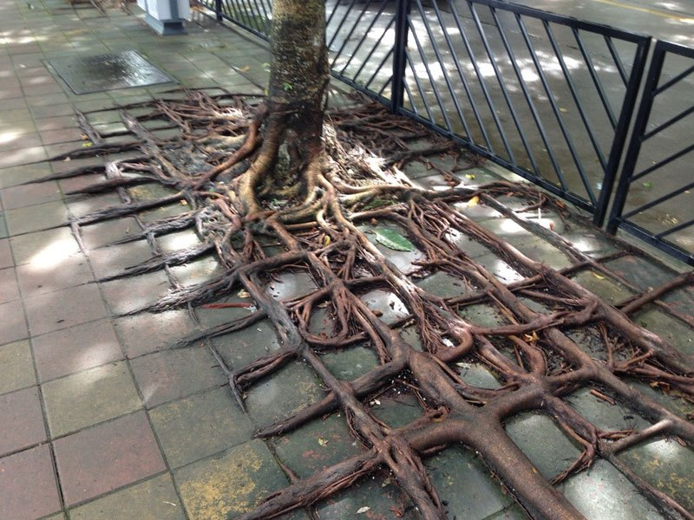
Concept Development
CFU
What is a square root?
Square Root – Square rooting a number is the opposite of squaring a number. Its symbol is √.
√ 100 = 10 √64 = 8
√36 = 6 √16 = 4
√4 = 2 √6.25 = 2.5

Slide 20
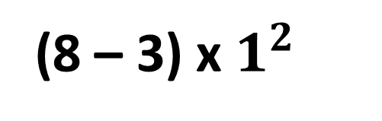
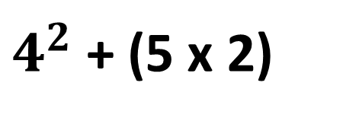
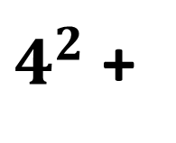
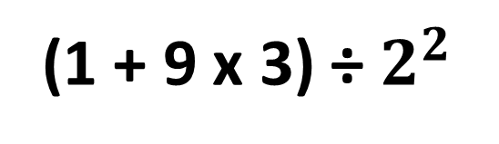
Daily Review
CFU
UNDERLINE, DO and DROP.
What does BIMDAS stand for?
BIMDAS
1. Brackets first.
2. Indices next.
3. Multiplication and Division in order from left to right.
4. Addition and Subtraction in order from left to right.
CFU
What order do you do addition and subtraction in?
CFU
What is the strategy for setting out your work?
Whiteboards
$4^{2}$ + (5 x 2)
Is there any:
1. Brackets?
(8 – 3) x $1^{2}$
(1 + 9 x 3) ÷ $2^{2}$
=
$4^{2}$ +
10
Yes! Underline, do & drop!
2. Indices?
Yes! Underline, do & drop!
=
16
+ 10
No
3. Multiplication or Division?
=
26
4. Addition or Subtraction?
Yes! Underline, do & drop!

Slide 21
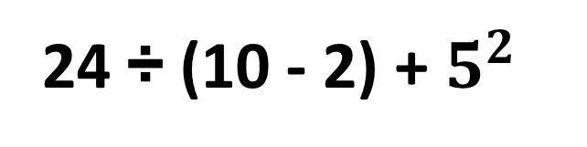
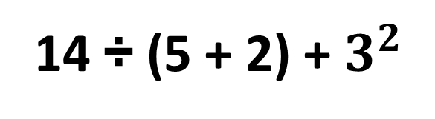
Daily Review
CFU
UNDERLINE, DO and DROP.
What does BIMDAS stand for?
BIMDAS
1. Brackets first.
2. Indices next.
3. Multiplication and Division in order from left to right.
4. Addition and Subtraction in order from left to right.
CFU
What is the strategy for setting out your work?
Whiteboards
$4^{2}$ + (5 x 2)
24 ÷ (10 - 2) + $5^{2}$
14 ÷ (5 + 2) + $3^{2}$
=
$4^{2}$ +
10
=
16
+ 10
=
26

Slide 22
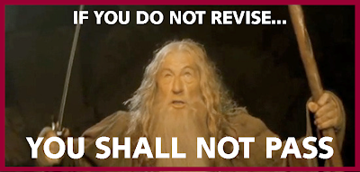
Skill Closure
What have we learnt today?
Lesson Objectives:
I will review my work on whole numbers
3500 ÷ 100
35 ÷ 1 = 35

Slide 23


Independent Practice
Mathematics Page Layout
Open your textbooks to:
Chapter: Chapter Review
Pages: 50 – 52
Questions: Fluency Onwards
1 – 21 (do every second question of
multi-part questions)

